Slide 1
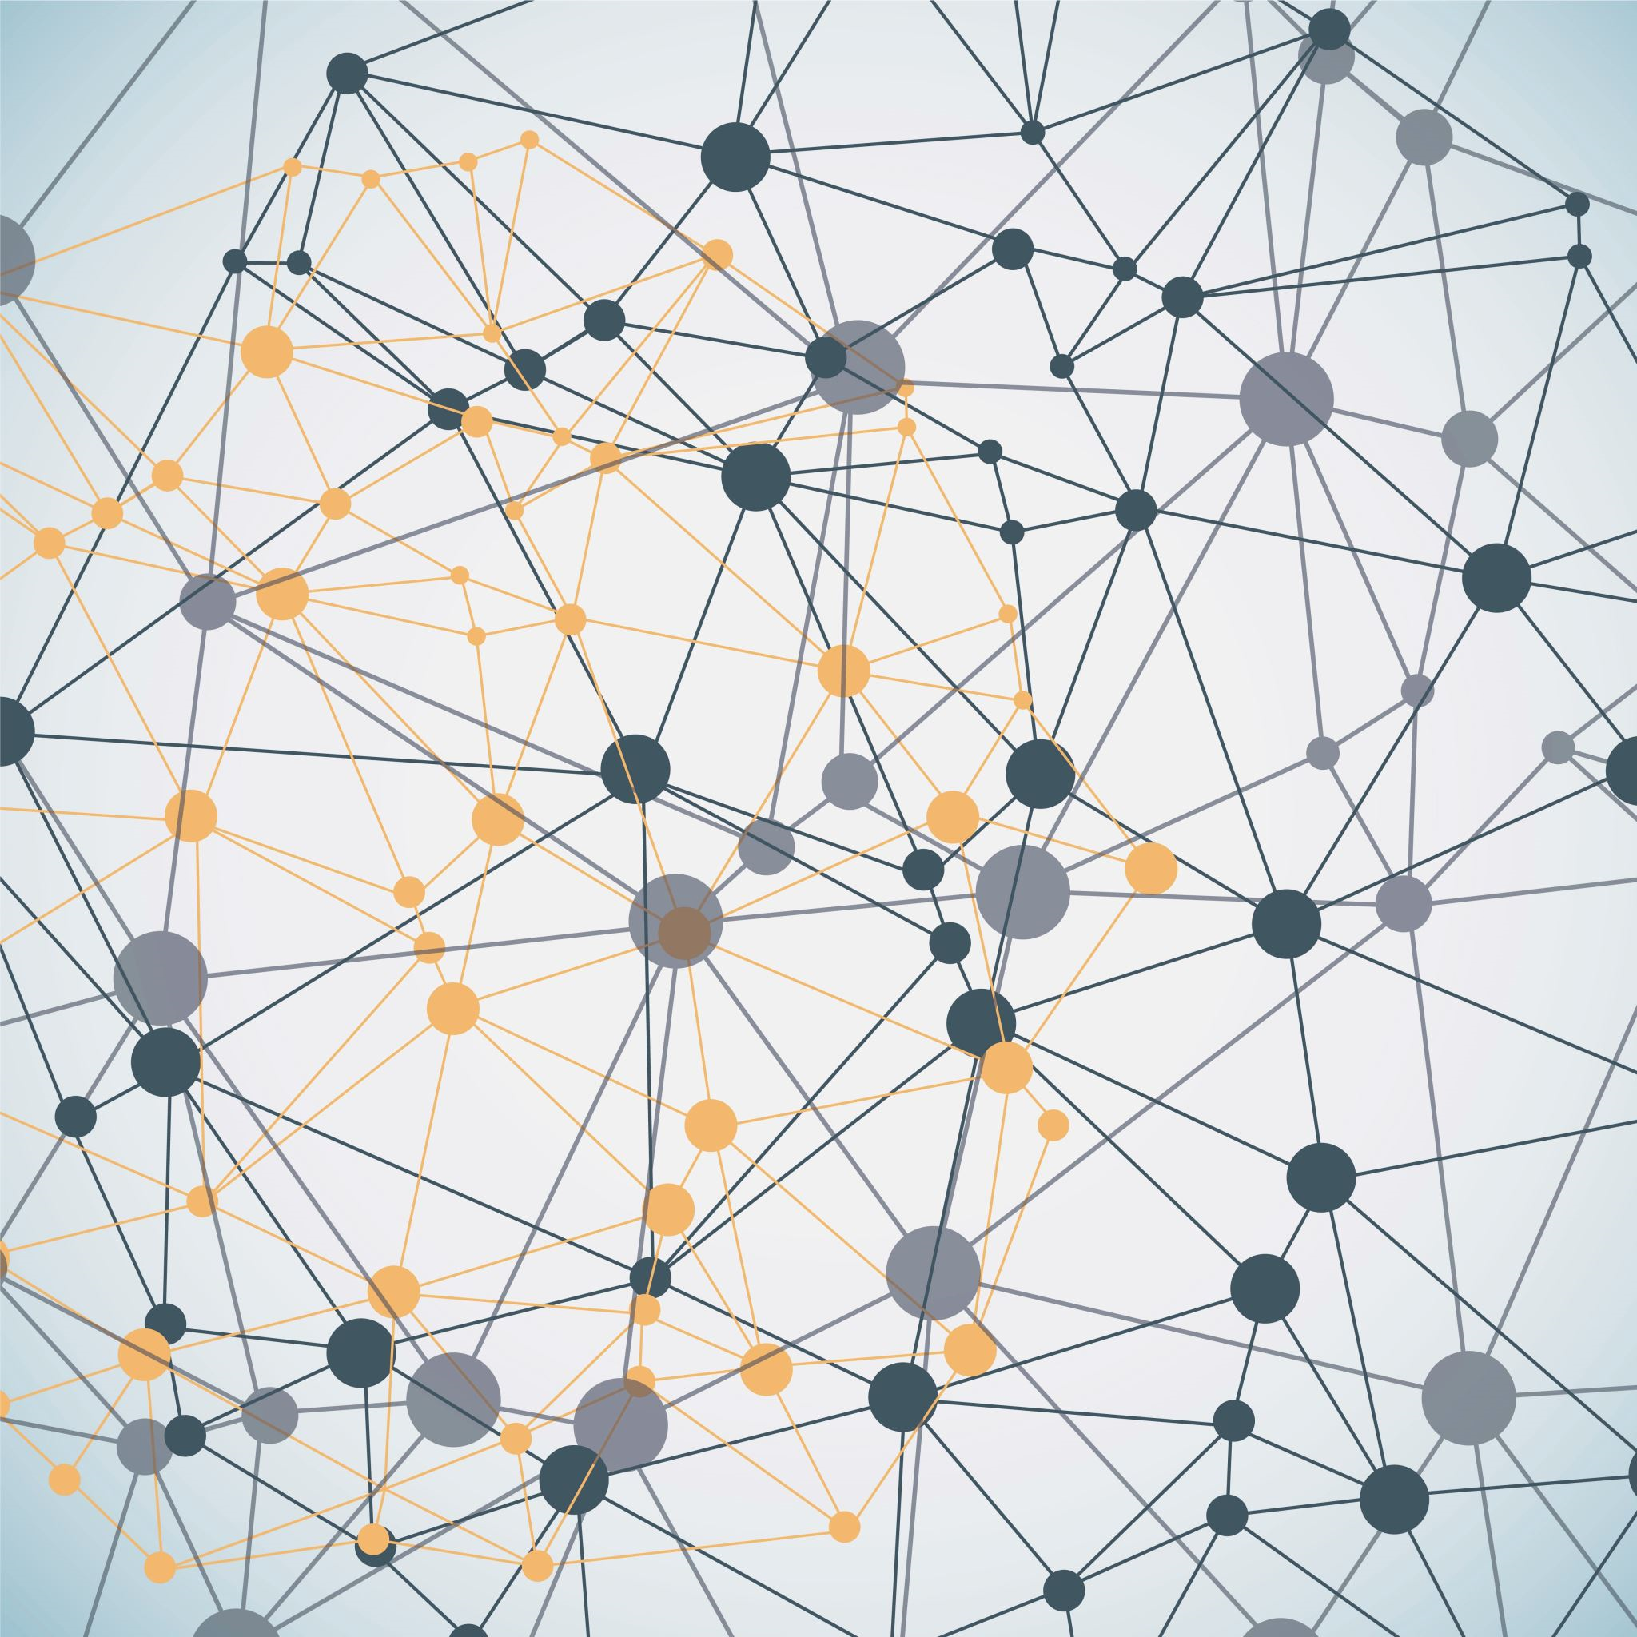
Ethics of Self-Driving Cars Safety & Liability
QUESTIONS
• Who is responsible for injuries and damage?
• What is the acceptable safety threshold?
• Can a faster roll-out prevent harm?
JUSTIFICATION
• Self-driving cars will affect everyone
• Impacts may be positive, but not for everyone
• Autonomous vehicles require new legislation
• We must make sure self-driving cars aren’t abused for ill intent
0812 01/05/2023
Thomas R • Dylan S • Matt S

